Slide 1
Introduction to Python Session 1
Notes:
1

Slide 2



Objectives
Appreciate the larger phenomenon of Open Source Software (OSS)
Understand what programing languages like Python mean
Introduce some of the basic programing concepts
Notes:
Results of first essay is close to complete
1

Slide 3
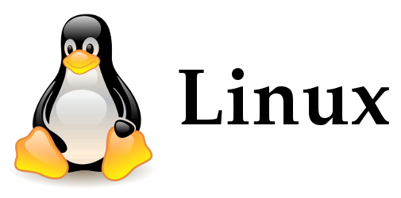

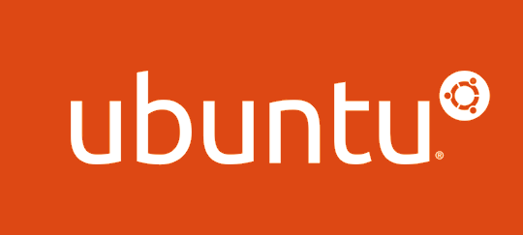

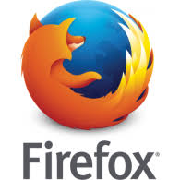

Open Source Software
Free and open source software
Source code is made available to everyone
Free as in freedom
A brief history
1960 to 1980: Academic setting with high autonomy
UNIX at Bell Labs
1980 to 1990s:Formalization of OSS
UNIX commercialised by AT&T
Richard Stallman creates FSF and GNU licence
Eric Raymond creates OSI
Post 1990: Organizations embrace OSS
2001 IBM opens its 40$mn software – eclipse software foundation
2016 Google has started over 900 OSS projects
Best Examples – Linux, Apache, Python
Notes:
Platforms
1

Slide 4
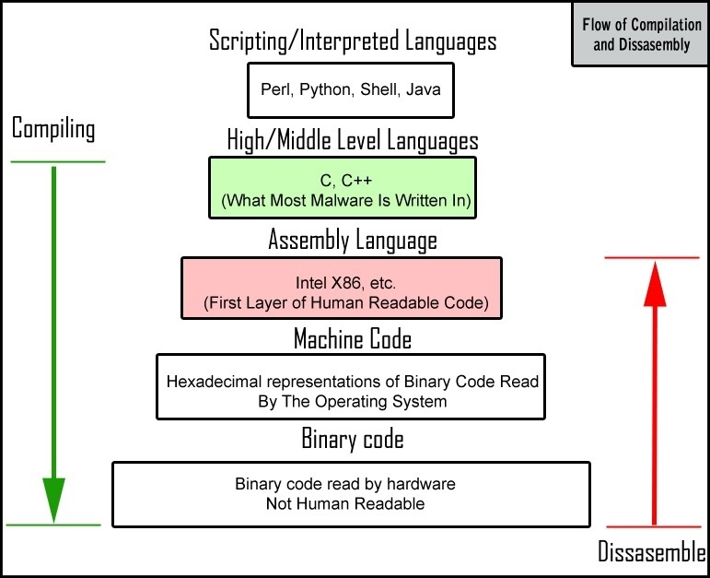
Programming Language
Alan Turing and computing
Formalizing the concept of algorithm and computation with the Turing Machine
Stored program computer – treat algorithms as data
Programming language
It is how we communicate with machines
From GUI to Machine level language
Syntax
A set of rules that define how the programming language is written
Grammar of programming language
Notes:
Platforms
1

Slide 5
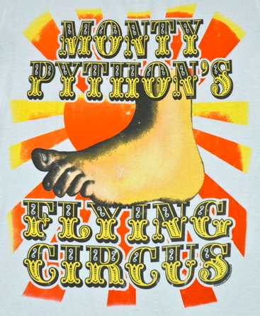
Python
Simplicity
High level language built on C
Benefits of being high level and at the same time provides for CPU-efficient code
Usability
Lots of documentation
Active development community to answer questions - stackexchange
Extensibility
Small core language with a large standard library and an easily extensible interpreter
Leverage OSS community by allowing for extensibility
Notes:
Platforms
1

Slide 6
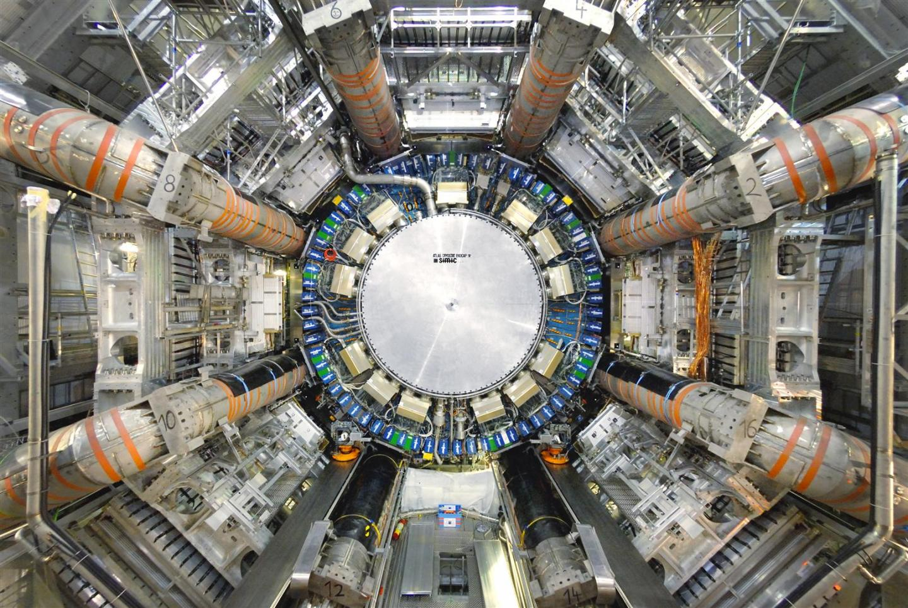
Python for BIGDATA
Big data management using Python
CERN and Large Hadron Collider
Particle detector (Atlas)
Data equivalent to 100 Megapixel camera taking 40 million pictures a second
Needle in a haystack – couple quadrillion collisions to find 1000 collisions that results in Higgs Boson
Pre-process this stunning amount of data in real time and store only the relevant for further analysis
Notes:
Platforms
1

Slide 7
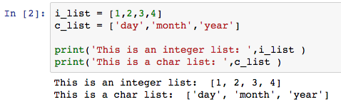
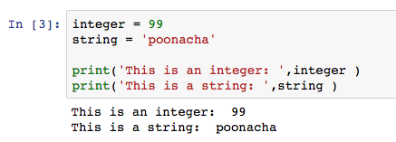
Programing Concepts- Data and types
Object Oriented Programing (OOP)
Data over actions
What we really care about are the objects we want to manipulate rather than the logic required to manipulate them
Classes and objects
Data types - Integer, float, string and boolean
Data structures – lists, dictionaries and tuples
Data structures combine the basic datatypes (integer, float, string, boolean) to create more complex types
Notes:
Not just a logical procedure that takes input data, processes it, and produces output data
1

Slide 8
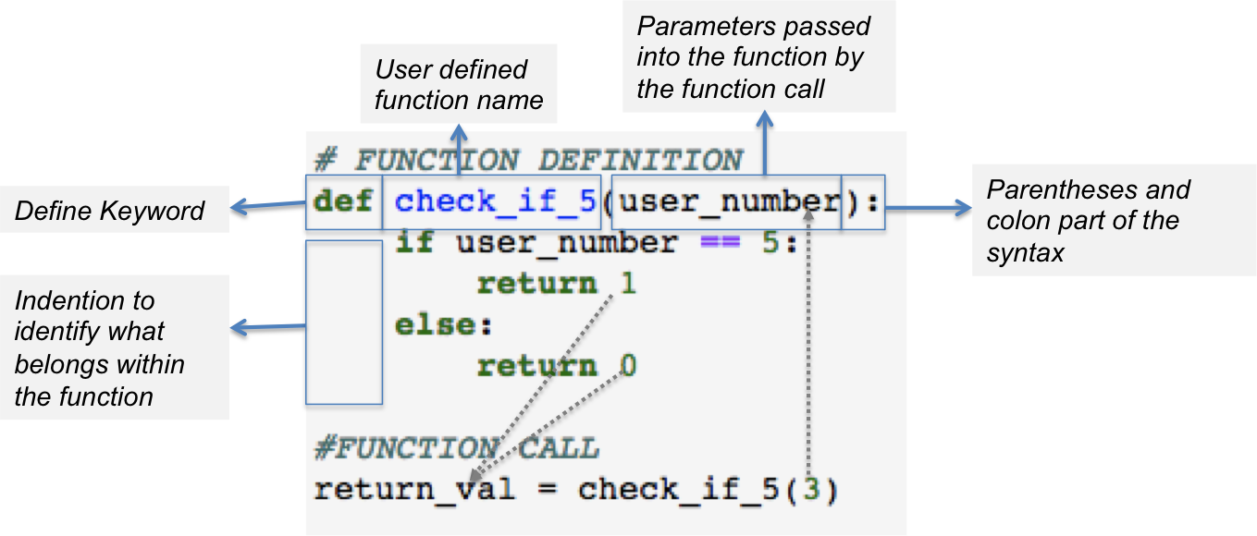
Programing Concepts – FUNCTIONS AND MODULES
Block of organized, reusable code that is used to perform a single, related action
Provide better modularity for your application and a high degree of code reusing
Python gives you many built-in functions like print(), len() etc..
It is also possible to define user-defined functions
Module : A set of related functions can be grouped together as module
The open source community continuously builds modules and makes it available for us
To access these modules we need to use the "import command” eg. import random
Notes:
Not just a logical procedure that takes input data, processes it, and produces output data
1

Slide 9
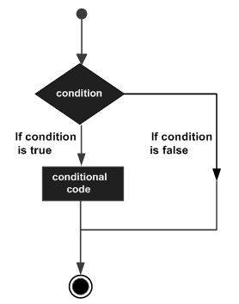
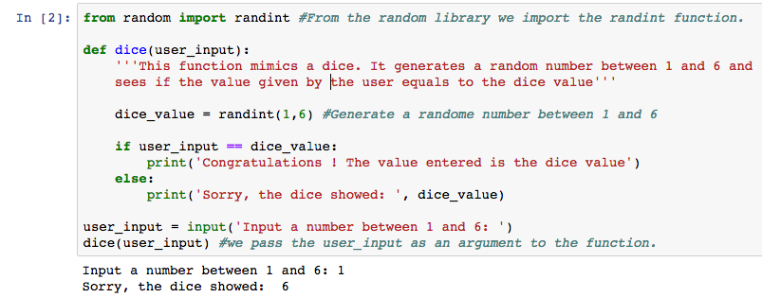
Programing Concepts – CONDITIONS AND CONTROLS
Evaluate expressions which produce TRUE or FALSE as outcome
Based on the outcome of the expression a specific block of code is executed
The expressions could be: equality (==) , inequality (!=), less/greater than (<)(>), less/greater than or equal (<=) (>=), membership (in, not in)
Expressions can be combined using "and" and "or" and "and not"
Notes:
Not just a logical procedure that takes input data, processes it, and produces output data
<number>

Slide 10
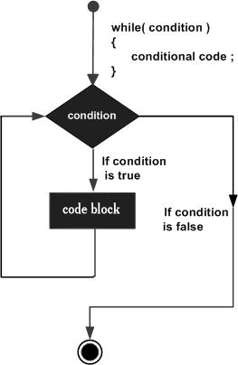
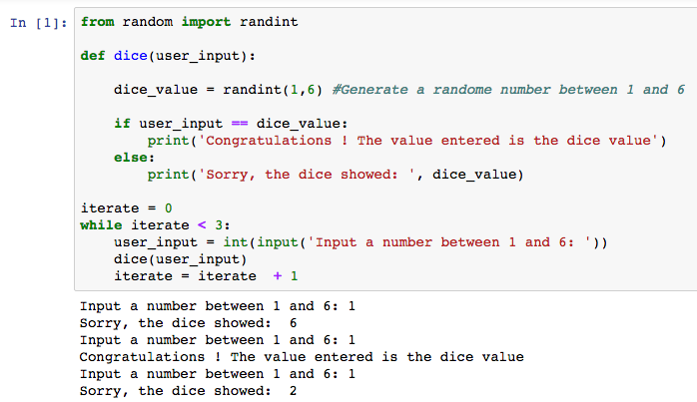
Programing Concepts - LOOPS
A loop statement allows us to execute a statement or group of statements multiple times
While loop is the simplest loop which executes a block of code until and expression is True
A 'break' command can be used to exit any loop prematurely
A 'continue' command can be used to skip ahead to the next iterations without exiting the loop
Notes:
Not just a logical procedure that takes input data, processes it, and produces output data
<number>

